Slide 1
M23DE0202 – Object Oriented Programming using JAVA
II Semester MCA Academic Year : 2024 - 2025
School of Computer Science and Applications
Pinaka Pani. R
Assistant Professor

Slide 2
Unit IV
Introduction to GUI and JDBC Programming

Slide 3
Java Swing is a part of Java Foundation Classes (JFC) and is used for building graphical user interfaces (GUIs) in Java applications.
It provides a set of "lightweight" (all-Java language) components that, unlike the earlier AWT (Abstract Window Toolkit) components, are platform-independent.
Key Features of Java Swing
Platform Independence:
Swing components are written entirely in Java and thus run consistently on any platform that supports Java.
Rich Set of Components:
Swing offers a wide range of components, including buttons, labels, text fields, tables, trees, and more complex components like tabbed panes and scroll panes.

Slide 4
Customization:
Swing components are highly customizable. You can change the look and feel of the components using the Pluggable Look And Feel (PLAF) architecture.
Event-Driven Programming:
Swing is based on the Model-View-Controller (MVC) architecture. This means that the data (model), presentation (view), and user input handling (controller) are separated, making it easier to manage and maintain applications.
Lightweight Components:
Swing components are lightweight in the sense that they are written entirely in Java and do not rely on native code. This makes them more flexible and portable.

Slide 5
Java Foundation Classes (JFC) :
JFC is short for Java Foundation Classes, which encompass a group of features for building graphical user interfaces (GUIs) and adding rich graphics functionality and interactivity to Java applications.
JFC was first announced at the 1997 JavaOne developer conference. It is defined as containing the features shown in the table below.

Slide 6
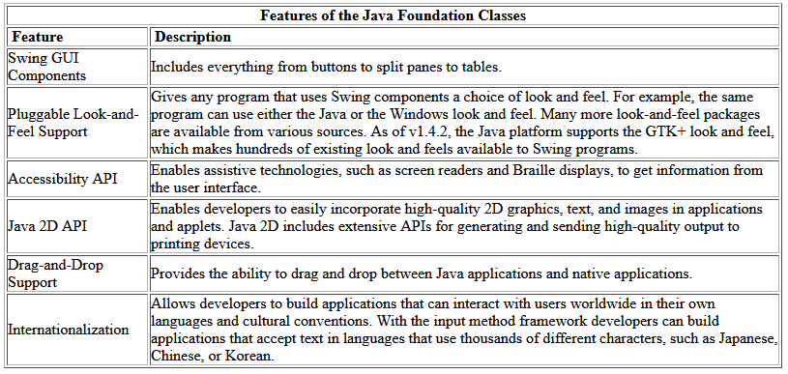

Slide 7
Compiling and Running Swing Programs
To compile and run a Swing application.
The compilation instructions work for all Swing programs — applets, as well as applications.
Create a program that uses Swing components.
Compile the program.
Run the program.

Slide 8
Basic Swing Components
JFrame: The main window container in a Swing application.
JFrame frame = new JFrame("My Swing Application");
frame.setSize(400,300); frame.setDefaultCloseOperation(JFrame.EXIT_ON_CLOSE);
frame.setVisible(true);
JPanel: A generic container for grouping other components.
JPanel panel = new JPanel();
frame.add(panel);
JButton:
A button component that can trigger actions when clicked.
JButton button = new JButton("Click Me");
panel.add(button);

Slide 9
JLabel:
A text or image display area.
JLabel label = new JLabel("Hello, Swing!");
panel.add(label);
JTextField:
A single-line text input field.
JTextField textField = new JTextField(20);
panel.add(textField);
JTextArea:
A multi-line text input area.
JTextArea textArea = new JTextArea(5, 20);
panel.add(new JScrollPane(textArea));

Slide 10
import javax.swing.*;
import java.awt.event.ActionEvent;
import java.awt.event.ActionListener;
public class SimpleSwingApp
{
public static void main(String[] args)
{
// Create the main frame
JFrame frame = new JFrame("Simple Swing App");
frame.setSize(400, 300);
frame.setDefaultCloseOperation(JFrame.EXIT_ON_CLOSE);
// Create a panel to hold components
JPanel panel = new JPanel();
frame.add(panel); placeComponents(panel); // Display the frame frame.setVisible(true);
}

Slide 11
private static void placeComponents(JPanel panel)
{
panel.setLayout(null);
// Create a label
JLabel userLabel = new JLabel("User:");
userLabel.setBounds(10, 20, 80, 25);
panel.add(userLabel);
// Create a text field
JTextField userText = new JTextField(20); userText.setBounds(100, 20, 165, 25); panel.add(userText);

Slide 12
// Create a button
JButton loginButton = new JButton("Login");
loginButton.setBounds(10, 80, 80, 25); panel.add(loginButton); // Add action listener to button loginButton.addActionListener(new ActionListener()
{
public void actionPerformed(ActionEvent e)
{
JOptionPane.showMessageDialog(null, "Button Clicked!"); } }); } }

Slide 13
Running the Application
To run this application:
Save the code to a file named SimpleSwingApp.java.
Compile the file using the command: javac SimpleSwingApp.java.
Run the compiled class using: java SimpleSwingApp.
This application creates a simple window with a text field and a button. When the button is clicked, a dialog box is displayed.

Slide 14
JFrame
The JFrame is the main window container for a Swing application.
It provides a window with borders, a title, and buttons to close, minimize, and maximize.
import javax.swing.JFrame;
public class MyFrame {
public static void main(String[] args) {
JFrame frame = new JFrame("My First Frame");
frame.setSize(400, 300); frame.setDefaultCloseOperation(JFrame.EXIT_ON_CLOSE); frame.setVisible(true); } }
Introduction to basic Widgets in Java

Slide 15
Layout managers in Java
Layout managers in Java Swing are used to arrange components within a container (such as a JFrame or JPanel).
They control the size and position of the components, making it easier to create complex and responsive user interfaces.

Slide 16
Types of Layout Manager in Java
Layout managers define how components are arranged within a container, such as a JFrame or JPanel.
Java provides several layout managers to suit various design needs.
1. FlowLayout
2. BorderLayout
3. GridLayout
4. CardLayout
5. BoxLayout
6. GridBagLayout

Slide 17

FlowLayout
FlowLayout is the default layout manager for every JPanel.
It simply lays out components in a single row, starting a new row if its container isn't sufficiently wide.

Slide 18
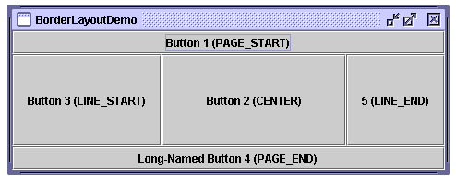
BorderLayout
Every content pane is initialized to use a BorderLayout.
(As Using Top-Level Containers (in the Creating a GUI with JFC/Swing trail) explains, the content pane is the main container in all frames, applets, and dialogs.)
A BorderLayout places components in up to five areas: top, bottom, left, right, and center.
All extra space is placed in the center area.

Slide 19
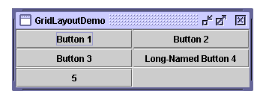
GridLayout
GridLayout simply makes a bunch of components equal in size and displays them in the requested number of rows and columns.

Slide 20
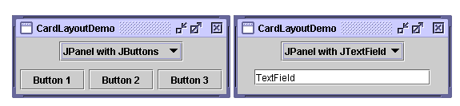
CardLayout
The CardLayout class lets you implement an area that contains different components at different times.
A CardLayout is often controlled by a combo box, with the state of the combo box determining which panel (group of components) the CardLayout displays.
An alternative to using CardLayout is using a tabbed pane (in the Creating a GUI with JFC/Swing trail), which provides similar functionality but with a pre-defined GUI

Slide 21
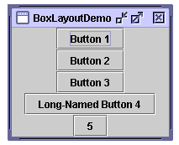
BoxLayout
The BoxLayout class puts components in a single row or column. It respects the components' requested maximum sizes and also lets you align components.

Slide 22
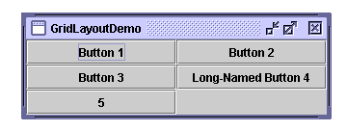
GridBagLayout
GridLayout simply makes a bunch of components equal in size and displays them in the requested number of rows and columns.

Slide 23
Event Handling
It refers to the process of managing and responding to user interactions or system-generated actions, such as clicking a button, typing text, moving the mouse, or closing a window.
It is a key feature in building interactive GUI applications using Java Swing, AWT, or JavaFX.

Slide 24
Event: An object representing an action or occurrence, such as a button click or a mouse movement.
This mechanism is central to building interactive applications, especially those with graphical user interfaces (GUIs).
For example:
ActionEvent: Triggered by actions like clicking a button.
MouseEvent: Triggered by mouse actions like clicking or moving the mouse.
KeyEvent: Triggered by keyboard actions like pressing a key.

Slide 25
Event Source: The object that generates an event.
A JButton can generate an ActionEvent when clicked.
A JTextField can generate a KeyEvent when a key is pressed.
Event Listener: An interface in Java that listens to events and provides callback methods to respond to them.
ActionListener: Listens to ActionEvent.
MouseListener: Listens to MouseEvent.
KeyListener: Listens to KeyEvent.

Slide 26
Event Handler: A method that implements the logic for responding to the event.
This method is defined in the listener.
Event Delegation Model: Which separates the event source from the event handling logic.
It works as follows:
The event source generates the event.
The listener is registered with the source.
When the event occurs, the event source notifies the listener.

Slide 27
How Event Handling Works
Registering a Listener:
An event source (e.g., a button) must register a listener object to listen for events. The listener object implements the listener interface.
Generating an Event:
When a user interacts with the source (e.g., clicks a button), an event object is created.
Notifying the Listener:
The event source notifies all registered listeners, and the appropriate method in the listener interface is called.

Slide 28
Listener Interface | Event Type | Methods
ActionListener | Action events | actionPerformed(ActionEvent e)
MouseListener | Mouse events | mouseClicked, mousePressed, etc.
KeyListener | Keyboard events | keyPressed, keyReleased, etc.
ItemListener | Item events (checkboxes, etc.) | itemStateChanged(ItemEvent e)
WindowListener | Window events | windowOpened, windowClosing, etc.

Slide 29
Event Handling Models
Delegation Event Model (Preferred)
The event handling mechanism in Java uses this model:
  The event is delegated to a listener object that implements the appropriate listener interface.
  It improves separation of concerns, as the event source and event handling logic are decoupled.
Event Handling in AWT/Swing
Java Swing and AWT use the delegation model, where GUI components generate events, and listeners handle them.

Slide 30
Advantages of Event Handling
Separation of Logic: Keeps the user interface code separate from the event handling code.
Reusability: Listener objects can be reused for handling multiple events.
Flexibility: Different listeners can be attached to a single event source, or a single listener can handle multiple events.

Slide 31
JPanel
A JPanel is a generic container that can hold other components.
It helps to organize and group components within a JFrame.
import javax.swing.JFrame;
import javax.swing.JPanel;
public class MyPanel
{ public static void main(String[] args)
{ JFrame frame = new JFrame("Panel Example");
JPanel panel = new JPanel(); frame.add(panel);
frame.setSize(400, 300); frame.setDefaultCloseOperation(JFrame.EXIT_ON_CLOSE); frame.setVisible(true); } }
JButton
A JButton is a button that can trigger an action when clicked.

Slide 32
JTextField
A JTextField is a single-line text input field
.
JLabel
A JLabel is a display area for a short text string or an image.
JCheckBox
A JCheckBox is a component that can be either selected or deselected.
JRadioButton
A JRadioButton is a button that can be selected or deselected, and is usually used in a group where only one button can be selected at a time.

Slide 33
JComboBox
JComboBox is a drop-down list that allows the user to choose one item from a list.
These basic widgets provide the foundation for creating user interfaces in Java Swing.
You can combine them, customize their appearance, and add functionality to create rich and interactive applications.

Slide 34
Step-by-Step Example: Simple Swing Application
Java Swing is a powerful toolkit for building graphical user interfaces (GUIs) in Java applications.
Steps for Swing components (a frame, panel, button, text field, label, and some event handling).
1. Setting Up the Main Frame
The JFrame is the main window of the application. We'll set up a basic frame with a title, size, and a close operation.

Slide 35
import javax.swing.JFrame;
public class SimpleSwingApp {
public static void main(String[] args) {
JFrame frame = new JFrame("Simple Swing App");
frame.setSize(400, 300); frame.setDefaultCloseOperation(JFrame.EXIT_ON_CLOSE);
frame.setVisible(true); } }

Slide 36
2.Adding a Panel
Next, we add a JPanel to the frame. A panel is a container that can hold other components.
import javax.swing.JFrame; import javax.swing.JPanel; public class SimpleSwingApp { public static void main(String[] args) { JFrame frame = new JFrame("Simple Swing App"); frame.setSize(400, 300); frame.setDefaultCloseOperation(JFrame.EXIT_ON_CLOSE); JPanel panel = new JPanel();
frame.add(panel);
frame.setVisible(true); } }

Slide 37
3.Adding Components to the Panel
We'll add a label, text field, and button to the panel.
import javax.swing.*;
public class SimpleSwingApp {
public static void main(String[] args) {
JFrame frame = new JFrame("Simple Swing App");
frame.setSize(400, 300); frame.setDefaultCloseOperation(JFrame.EXIT_ON_CLOSE);
JPanel panel = new JPanel();
frame.add(panel);
placeComponents(panel);
frame.setVisible(true);
} private static void placeComponents(JPanel panel)
{
panel.setLayout(null); JLabel userLabel = new JLabel("User:");

Slide 38
userLabel.setBounds(10, 20, 80, 25);
panel.add(userLabel);
JTextField userText = new JTextField(20);
userText.setBounds(100, 20, 165, 25);
panel.add(userText);
JButton loginButton = new JButton("Login");
loginButton.setBounds(10, 80, 80, 25);
panel.add(loginButton); } }

Slide 39
4. Adding Event Handling
Add an action listener to the button to display a message when it is clicked.
import javax.swing.*;
import java.awt.event.ActionEvent;
import java.awt.event.ActionListener;
public class SimpleSwingApp {
public static void main(String[] args)
{
JFrame frame = new JFrame("Simple Swing App");
frame.setSize(400,300); frame.setDefaultCloseOperation(JFrame.EXIT_ON_CLOSE);
JPanel panel = new JPanel();
frame.add(panel); placeComponents(panel);
frame.setVisible(true);
}

Slide 40
private static void placeComponents(JPanel panel)
{
panel.setLayout(null);
JLabel userLabel = new JLabel("User:");
userLabel.setBounds(10, 20, 80, 25);
panel.add(userLabel);
JTextField userText = new JTextField(20);
userText.setBounds(100, 20, 165, 25);
panel.add(userText); JButton loginButton = new JButton("Login");
loginButton.setBounds(10,80,80,25);
panel.add(loginButton); loginButton.addActionListener(new ActionListener()
{

Slide 41
public void actionPerformed(ActionEvent e)
{
String username = userText.getText(); JOptionPane.showMessageDialog(null, "Hello, " + username + "!"); } }); } }

Slide 42
import javax.swing.*;
import java.awt.event.ActionEvent;
import java.awt.event.ActionListener;
public class SimpleSwingApp
{
public static void main(String[] args)
{
JFrame frame = new JFrame("Simple Swing App");
frame.setSize(400, 300); frame.setDefaultCloseOperation(JFrame.EXIT_ON_CLOSE);
JPanel panel = new JPanel(); frame.add(panel);
placeComponents(panel);
frame.setVisible(true); }
private static void placeComponents(JPanel panel)
{
panel.setLayout(null);

Slide 43
JLabel userLabel = new JLabel("User:");
userLabel.setBounds(10, 20, 80, 25);
panel.add(userLabel);
JTextField userText = new JTextField(20);
userText.setBounds(100, 20, 165, 25);
panel.add(userText);
JButton loginButton = new JButton("Login");
loginButton.setBounds(10, 80, 80, 25);
panel.add(loginButton);
loginButton.addActionListener(new ActionListener()
{
public void actionPerformed(ActionEvent e)
{
String username = userText.getText();
JOptionPane.showMessageDialog(null, "Hello, " + username + "!"); } }); } }

Slide 44
Running the Application
To run this application:
Save the code to a file named SimpleSwingApp.java.
Compile the file using the command: javac SimpleSwingApp.java.
Run the compiled class using: java SimpleSwingApp.
This application creates a simple window with a text field and a button. When the button is clicked, a dialog box displays a message with the entered username.

Slide 45
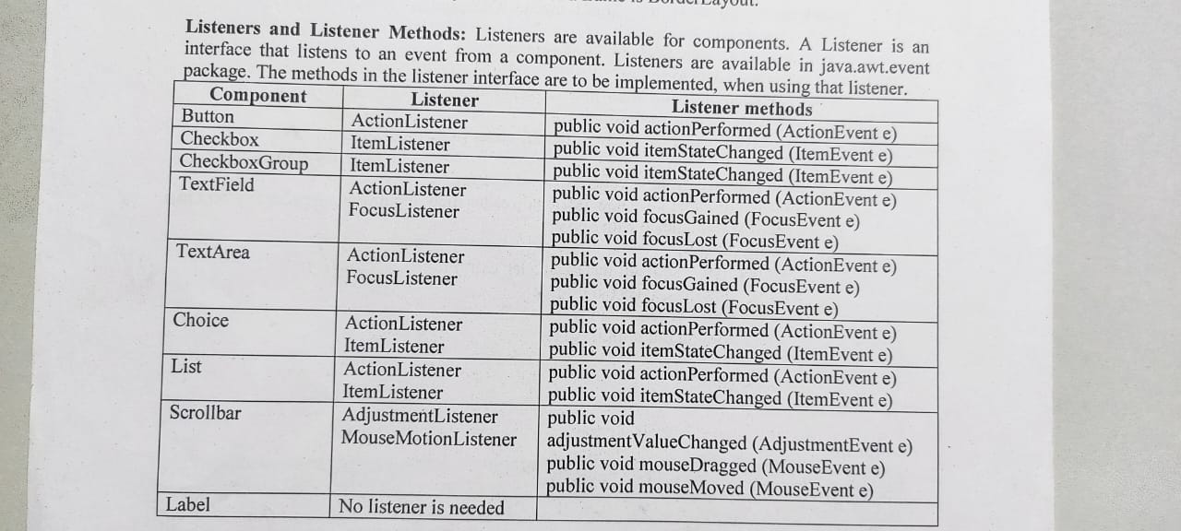

Slide 46
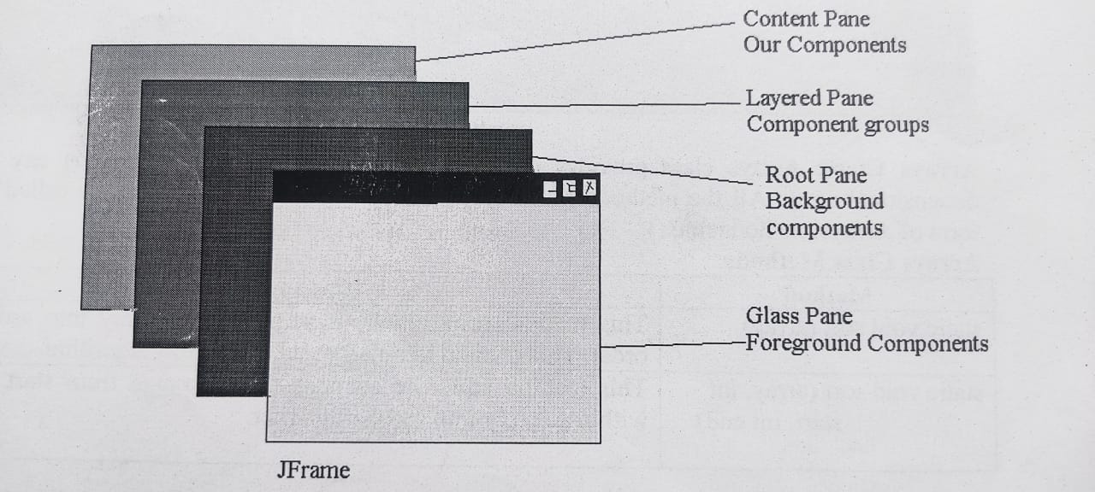

Slide 47
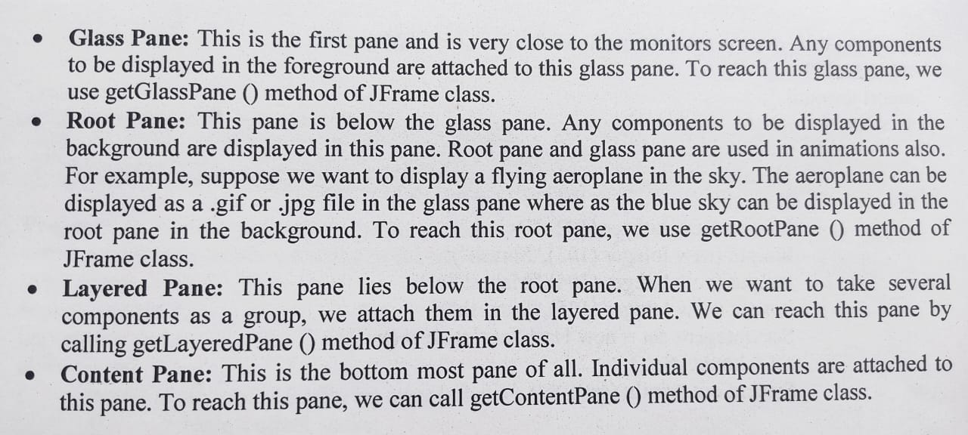

Slide 48
Java Database Connectivity (JDBC):
Is a Java-based API that allows Java applications to interact with databases.
JDBC provides a standard interface for connecting to relational databases, executing SQL queries, and retrieving results.
Key Components of JDBC
JDBC Driver
  A JDBC driver is a software component that enables Java applications to interact with a database. Different databases require different JDBC drivers.
  Types of JDBC Drivers:
    Type 1: JDBC-ODBC Bridge Driver
    Type 2: Native-API Driver
    Type 3: Network Protocol Driver
    Type 4: Thin Driver (Pure Java driver)

Slide 49
Connection
  Represents a connection to a specific database. It is used to create statements and manage transactions.
  Example: Connection conn = DriverManager.getConnection(url, user, password);

Slide 50
Statement
  Used to execute SQL queries against the database. There are three types:
    Statement: Used for simple SQL statements without parameters.
    PreparedStatement: Used for precompiled SQL statements with parameters.
    CallableStatement: Used to execute stored procedures.
ResultSet
  Represents the result set of a query. It is used to iterate over the data returned by the query.
  Example: ResultSet rs = stmt.executeQuery("SELECT * FROM users");

Slide 51
Basic Steps to Use JDBC
Load the JDBC Driver
  Ensure that the JDBC driver is available in your classpath. For example, for MySQL, you would need mysql-connector-java.jar.
  Load the driver class (not necessary for newer JDBC versions as the driver auto-registers).
try { Class.forName("com.mysql.cj.jdbc.Driver"); } catch (ClassNotFoundException e) { e.printStackTrace(); }
Establish a Connection
  Use DriverManager.getConnection() to establish a connection to the database.
java
String url = "jdbc:mysql://localhost:3306/mydatabase";
String user = "username";
String password = "password";
Connection conn = null;
try { conn = DriverManager.getConnection(url, user, password); } catch (SQLException e) { e.printStackTrace(); }

Slide 52
Create a Statement
  Use the Connection object to create a Statement object.
Statement stmt = null; try { stmt = conn.createStatement(); } catch (SQLException e) { e.printStackTrace(); }
Execute a Query
  Execute SQL queries using the Statement object and obtain the result.
ResultSet rs = null; try { rs = stmt.executeQuery("SELECT * FROM users"); } catch (SQLException e) { e.printStackTrace(); }
Process the ResultSet
  Iterate over the ResultSet to process the data returned by the query.
try { while (rs.next()) { int id = rs.getInt("id"); String name = rs.getString("name"); System.out.println("ID: " + id + ", Name: " + name); } } catch (SQLException e) { e.printStackTrace(); }

Slide 53
Close the Resources
  Close the ResultSet, Statement, and Connection objects to free up resources.
try { if (rs != null) rs.close(); if (stmt != null) stmt.close(); if (conn != null) conn.close(); } catch (SQLException e) { e.printStackTrace(); }
Example: JDBC Program to Query a Database
Here's a complete example that demonstrates how to use JDBC to connect to a MySQL database, execute a query, and process the results:

Slide 54
Type 1: JDBC-ODBC Bridge (rarely used, deprecated in Java 8).
Type 2: Native-API Driver (platform-dependent, requires native libraries).
Type 3: Network Protocol Driver (uses middleware server).
Type 4: Thin Driver (pure Java, recommended for most applications).

Slide 55
JDBC (Java Database Connectivity), statements
Statements are used to execute SQL queries or commands in a database.
There are three main types of statements:
Statement:
To execute simple SQL queries that don’t require any parameters.
Methods:
executeQuery(String sql) - For SELECT queries.
executeUpdate(String sql) - For INSERT, UPDATE, DELETE, and DDL commands.
execute(String sql) - For any SQL command.

Slide 56
Example:
Statement stmt = connection.createStatement();
ResultSet rs = stmt.executeQuery("SELECT * FROM employees");
Limitations:
Not suitable for dynamic or parameterized queries.
Less secure.

Slide 57
2. PreparedStatement
To execute precompiled SQL statements with dynamic parameters.
Methods:
set<Type>(int parameterIndex, <Type> value) - To set parameter values.
executeQuery() - For SELECT queries.
executeUpdate() - For INSERT, UPDATE, DELETE, and DDL commands.

Slide 58
Example:
String query = "SELECT * FROM employees WHERE department = ?";
PreparedStatement pstmt = connection.prepareStatement(query);
pstmt.setString(1, "Sales");
ResultSet rs = pstmt.executeQuery();
Advantages:
Prevents SQL injection.
Better performance for repeated execution.
Easier to work with dynamic queries.

Slide 59
3. CallableStatement
Purpose: Used to execute stored procedures in the database.
Methods:
set<Type>(int parameterIndex, <Type> value) - To set input parameter values.
registerOutParameter(int parameterIndex, int sqlType) - To register output parameters.
execute() - To execute the stored procedure.

Slide 60
Example:
CallableStatement cstmt = connection.prepareCall("{call getEmployeeDetails(?)}");
cstmt.setInt(1, 101);
ResultSet rs = cstmt.executeQuery();
Advantages:
Facilitates the use of complex SQL logic encapsulated in stored procedures.
Reduces network traffic when dealing with complex operations.

Slide 61
Each type has its unique use cases and should be chosen based on the specific requirements of the application.
Type | Use Case | Security | Performance
Statement | Simple queries without parameters | Vulnerable to SQL Injection | Slower due to query compilation every time
PreparedStatement | Queries with parameters, frequent execution | Prevents SQL Injection | Faster for repeated queries
CallableStatement | Executing stored procedures | Safe for use with stored procedures | Depends on procedure logic

Slide 62
DB Connectivity Steps

